Slide 1


Modernize with SQL Server 2019 and Intel® Technologies
Speaker Name, Title, Company
Presenting Sponsors:
Notes:
Use this slide as the title slide > if the title is very long, use the second option

Slide 2
SQL Server 2019:
The Modern Data Platform

Slide 3
Modernizing the WideWorldImporters Company
Mixture of SQL Server 2008, 2014, and 2016 servers
Expensive ETL applications for data sources outside of SQL Server
Should we use “Big Data” technologies?
Query performance tuning expensive
Some database applications suffer from I/O performance
Need data secure end-to-end with classification and auditing
Applications need better availability and less downtime
Our company uses a mixture of different operating system platforms
Popularity of containerized applications growing
What, when, and how should I migrate to the cloud?
Desire to build more intelligent applications with AI and Machine Learning

Slide 4



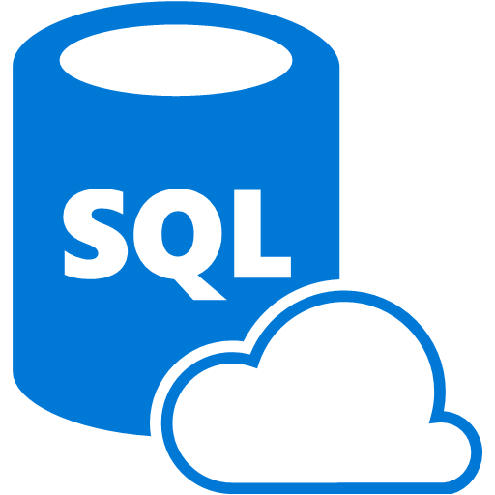
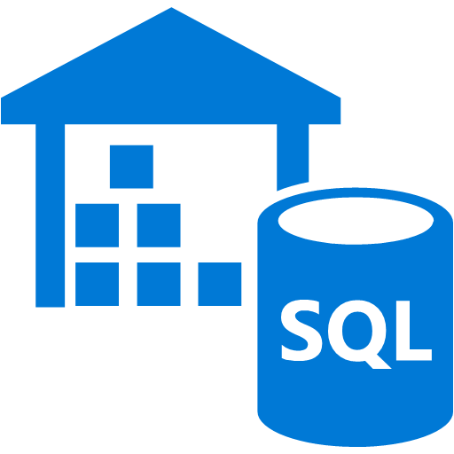
Azure Data Modernization Choices
SQL Server 2016
SQL Server 2017
SQL Server 2019
SQL Server in
Azure Virtual Machine (IaaS)
SQL Server 2008
SQL Server 2008R2
SQL Server 2012
SQL Server 2014
Azure SQL Database
Azure SQL Database Managed Instance
(PaaS)
Azure SQL Data
Warehouse

Slide 5

Modernize with SQL Server 2019
Now with big data clusters
Intelligence over any data
Choice of platform and language
Industry-leading performance
Most secure over the last 8 years⁵
Insights in minutes and rich reports
SQL
+
Analytics over structured and unstructured data with the power of SQL and Apache Spark
T-SQL
Java
C/C++
SCALA
Node.js
C#/VB.NET
Python
Ruby
.NET core
#1 OLTP performance¹
#1 DW performance on 1TB², 10TB³, and 30TB⁴
The best of Power BI and SQL Server Reporting Services in Power BI Report Server
In-memory across all workloads
Most consistent data platform
Private cloud
1/10th the cost of Oracle
Public cloud
All TPC Claims as of 1/19/2018.
¹ http://www.tpc.org/4081; ² http://www.tpc.org/3331; ³ http://www.tpc.org/3326; ⁴ http://www.tpc.org/3321; ⁵ National Institute of Standards and Technology Comprehensive Vulnerability Database

Slide 6







SQL Server 2019
Key New Functionality
ciphertext
Polybase++
Query
SQL
101001010110
Secure Enclaves
Intelligent Query Processing
Learn
Memory grant
Enclave
In-Memory Databases
plaintext
Cosmos DB
Run query
Built-in Machine Learning and Extensibility
High Availability
R
Modern Platforms with Compatibility
Notes:
This is animated in this sequence
Data Virtualization with Polybase and Big Data Clusters
Intelligent Query Processing and In-Memory databases
Security enhancements with Always encrypted with enclaves
New HA capabilities such as SQL AGs on k8s and Accelerated Database Recovery
Extensibility now with Java
Modern platforms choices with compatibility – Backup a db on any of these and restore to any of these

Slide 7
Intelligent Performance with SQL Server The intelligent database
The Intelligent Query Processing feature family
Intelligent QP
Adaptive QP
Table Variable Deferred Compilation
Batch Mode for Row Store
Approximate QP
Scalar UDF
inlining
Intelligent Query Processing
Performance insights anytime and anywhere with Lightweight Query Profiling
Accelerating I/O performance with Persistent Memory
TempDB: It Just Runs Faster Memory-optimized TempDB Metadata
Adaptive Joins
Interleaved Execution
Memory Grant Feedback
Approximate Count Distinct
Batch Mode
Batch Mode
Row Mode
Bold indicates new and improved features in SQL Server 2019
Notes:
After CTP 3.0, we will flush out “in-memory databases” further

Slide 8
Mission critical security Confidential computing
Always Encrypted with secure enclaves
plaintext
ciphertext
Always Encrypted with secure enclaves
Data Classification and auditing built-in
TDE scan suspend and resume
Simplified certificate management
Enhanced client driver
Enclave
plaintext
Notes:
Manage certificates easier with SQL Configuration Manager

Slide 9
High Availability Keep SQL Server running
Availability groups on Kubernetes
Kubernetes cluster
Node
Pod
Load balancer
Operator
Online Index Enhancements
Availability Groups Enhancements
System Databases (Planned)
Availability groups on Kubernetes
Accelerated Database Recovery
Reporting app
Node
Node
Node
Pod
Pod
Pod
SQL Server primary
SQL Server secondary
AG
SQL Server secondary
AG agent
AG agent
AG agent
Load balancer
Primary app
Notes:
Online index enhancements
Resumable online index creation
Online Clustered Columnstore index creation and rebuild
Always On availability group enhancements includes
Primary connection intent
More replicas
AGs for System Databases (Planned)
A later slide walks though the diagram on how AGs and k8s works

Slide 10
Enhancing the developer experience
Extend T-SQL with R, Python, and Java
Satellite
R
SQL Graph enhancements
UTF-8 support
Machine Learning Services enhancements
SQL Server Java extension
SQL Server
T-SQL
Direct communications for performance
Launch pad
Notes:
The diagram is to emphasize
Process isolation
Secure
Resource control with RG

Slide 11
SQL Server 2019 and Linux and Containers
Windows
Linux
New Features
Replication
Distributed transactions
Machine Learning
Polybase
The Microsoft Container Registry
Red Hat Images
Availability Groups on Kubernetes
Docker containers and Kubernetes

Slide 12

Why SQL Server and Containers?
Portable
Run anywhere Docker is supported
Lightweight
Reduced disk, CPU, and memory footprint
Consistent
Consistent image of SQL Server, scripts, and tools
Efficient
Faster deployment, reduced patching, and less downtime
Container configuration
Persisted storage
Database
Switch for
simple upgrades
Container
Container
Container
sqlservr
sqlservr
sqlservr
Bins/libs
Bins/libs
Bins/libs
Docker
Host OS
Infrastructure
Notes:
The right diagram is to show how to update SQL Server by “switching” containers

Slide 13
SQL Server - Shared storage HA in Kubernetes
Built-in HADR orchestration with no clustering required
Kubernetes
Node
Node
Node
Pod
Load Balancer Service
Pod
SQL Server
SQL Server
User
Pod
SQL Server
Persistent Volume Storage
Notes:
HA built into k8s for a single SQL instance

Slide 14
SQL Server 2019 Always On Availability Groups on Kubernetes
Availability groups on Kubernetes
Kubernetes cluster
Node
Pod
Load balancer
Operator
Reporting app
SQL Server/k8s failover integration
Operator deployment
AG concepts all apply
Load Balancer for Primary App
Load Balancer for Secondary Replica Readers
Node
Node
Node
Pod
Pod
Pod
SQL Server primary
SQL Server primary
SQL Server secondary
AG
SQL Server secondary
SQL Server secondary
AG agent
AG agent
AG agent
Load balancer
Primary app
Notes:
K8s doesn’t understand SQL health
AGs provide read replicas to offload reporting workloads

Slide 15




What is SQL Server Polybase?
“It’s all about
Data Virtualization”
Distributed compute engine integrated with SQL Server
Query data where it lives using T-SQL
Distributed, scalable query performance
Manual/deploy with SQL Server
Auto deploy/optimize with Big Data Clusters
Analytics
T-SQL
Apps
SQL Server
PolyBase external tables
ODBC
NoSQL
Relational databases
Big data
Excel
Cosmos DB
HDFS
Intelligence over all data
Notes:
Polybase came in SQL 2016 but we now have expanded the number of data sources
For NoSQL, Relational, and Hadoop, all client software built-in. ODBC is “bring your own driver” but opens up the possibilities
Note as of CTP 2.5, Polybase for Linux only supports NoSQL and Relational databases

Slide 16


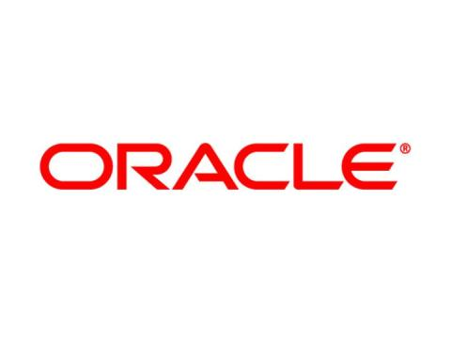


SQL Server 2019: Data Virtualization
Modern StockItems
Legacy Suppliers
Mobile
App Orders
SQL Server
2019
WideWorldimporters
Customers from Acquisition
Accounts Receivable
Order Reviews
Notes:
This is a great example for a company that has existing data sources but doesn’t want to or cannot move the data. This diagram can be demonstrated with a demo video or using the github examples at https://github.com/microsoft/sqlworkshops/tree/master/ModernizeYourDatabases2019/ModernizeSQL2019/Module%208%20Activity%20-%20Data%20Virtualization

Slide 17
SQL Server 2019 Big Data Clusters
Data virtualization
Managed SQL Server, Spark, and data lake
Complete AI platform
Admin portal and management services
Integrated AD-based security
Analytics
T-SQL
Apps
REST API containers for models
SQL Server External Tables
SQL Server
Spark
SQL Server
ML Services
Spark & Spark ML
Compute pools and data pools
Scalable, shared storage (HDFS)
Open database connectivity
NoSQL
Relational databases
HDFS
External data sources
HDFS
Combine data from many sources without moving or replicating it
Scale out compute and caching to boost performance
Store high volume data in a data lake and access it easily using either SQL or Spark
Management services, admin portal, and integrated security make it all easy to manage
Easily feed integrated data from many sources to your model training
Ingest and prep data and then train, store, and operationalize your models all in one system
Notes:
BDC is all about providing the install and configuration of Polybase automatically but if you don’t have Hadoop we will install one for you and include Spark with it. The right side of the slide is about using BDC as a complete ML/AI platform. All of this deployed on a cluster that is secure and provides built-in management, HA, and scale using Kubernetes.
Note: As of CTP 2.5, BDC does not support ODBC drivers for Polybase

Slide 18
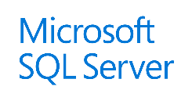



SQL Server Big Data Cluster Architecture
Control Plane
Controller Svc
Azure FSM Engine
Kibana
Grafana
Elastic Search
InfluxDB
Custom apps
BI
Analytics
Configuration Store (SQL Server)
Cluster
App Deploy
SQL
SQL Server master instance
External data sources
Compute pool
Compute pool
Compute pool
Directly read from HDFS
SQL Compute Node
SQL Compute Node
SQL Compute Node
SQL Compute Node
SQL Compute Node
…
Data mart
Storage pool
SQL Data Node
SQL Data Node
Spark
SQL Server
Spark
SQL Server
…
Spark
SQL Server
HDFS Data Node
HDFS Data Node
HDFS Data Node
IoT data
Storage
Storage
Kubernetes pod
HDFS Tiering
Node
Node
Node
Node
Node
Node
Node
Persistent storage
Notes:
Walk through the animation. All of this runs with the power of containers and Kubernetes.
Master instance is “just SQL Server”
Use external tables to access Hadoop data but not the same way as done in V1 Polybase (Java map/reduce). SQL Server talks to SQL Server which can read natively from HDFS. HDFS Tiering allows you to map your HDFS nodes to Azure Data Lake and Amazon S3 (and eventually into other Hadoop systems like Cloudera)
Spark jobs can also be run natively against Hadoop data
Scale out for external tables can be done via compute nodes
Other compute nodes can be used for relational and NoSQL data sources. Since it is Polybase, you can join all of this together
The Data Mart allows you to take query results and cache them using SQL Server and achieve super scale performance. Great for weekly refreshes for critical reports. You can also ingest data like IOT into the data mart
You can deploy apps into the cluster such as R or Python code or even SSIS jobs using app deploy.
A control plane works in the cluster for deployment, management, diagnostics, and controller services

Slide 19
The Customer Voice
String or binary data would be truncated
Columnstore stats in DBCC CLONEDATABASE
Estimate compression for Columnstore indexes
Diagnostics for auto stats blocking
The #1 voted customer feedback item of all time: String Truncation (1000+ votes)
Troubleshoot page resource waits with new built-in T-SQL
String or binary data would be truncated
in table '%.*ls', column '%.*ls’.
Truncated value: '%.*ls'
SELECT page_info.*
FROM sys.dm_exec_requests AS d
CROSS APPLY sys.fn_PageResCracker(d.page_resource) AS r
CROSS APPLY sys.dm_db_page_info(r.db_id, r.file_id, r.page_id,'DETAILED')
AS page_info;

Slide 20




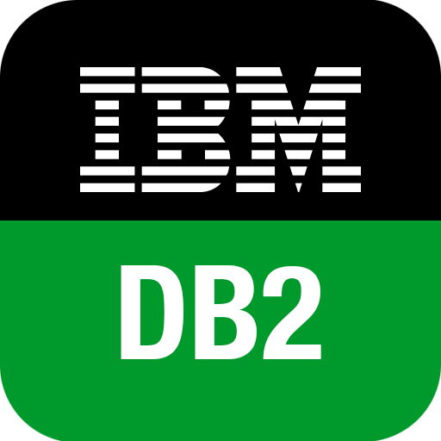

Migrate to the Modern SQL Server
Migration from legacy SQL Server
Migration from external databases
Azure Site Recovery
Database Experimentation
Assistant
Legacy SQL Server
SQL Server 2017
SQL Server 2019*
SQL Server in Azure Virtual Machine
Microsoft Access
In-Place (Windows)
Database Backup
Log Shipping
Bulk Import
SSIS
Data Migration
Assistant
Azure Database Migration Service
SQL Server Migration Assistant (SSMA)
Query Tuning Assistant
* Coming by GA

Slide 21
Learn more
http://aka.ms/bobwardms
http://aka.ms/bobsqldemos
http://aka.ms/sqllinuxbook
Use our free training at https://aka.ms/sqlworkshops
Learn from videos and demos at https://aka.ms/sqlchannel
Download and try it at http://aka.ms/ss19
What’s new for SQL 2019 documentation
Sign-up for the EAP program at https://aka.ms/eapsignup

Slide 22
SQL Server 2008 EOS Is Coming - Modernizing with Intel® Technologies
Notes:
[Moderator Part]
The moderator’s script will be added in this section after deck submission.

Slide 23
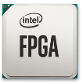



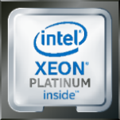




Data-Centric Infrastructure Focus
MOVE Faster
MOVE More
PROCESS Everything
ethernet
Silicon Photonics
Omni-Path fabric
Software & System-Level OPTIMIZED
Notes:
At Intel, we have been investing in silicon innovation for years to drive the right technology foundation to move, store and process data across the data centric compute landscape
This has included ongoing investment in our CPU portfolio, but also includes leading products for data movement such as our Ethernet product offerings, delivering storage innovation and efficiency with Intel Optane DC and QLC 3D NAND SSDs, and creating unique discrete compute acceleration with Stratix 10 FPGAs.
It also means accelerating investment in new spaces including discrete acceleration technologies for AI workloads, disruptive innovation for persistent memory, and networking with our Silicon Photonics products.

Slide 24
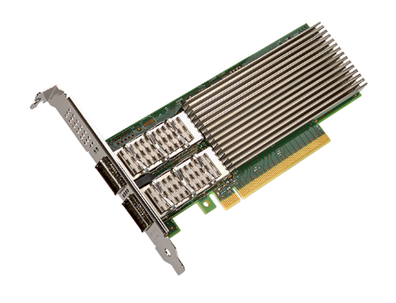
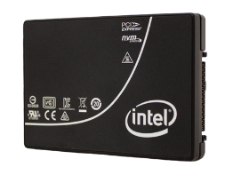
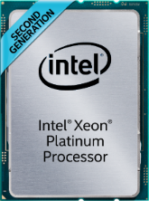
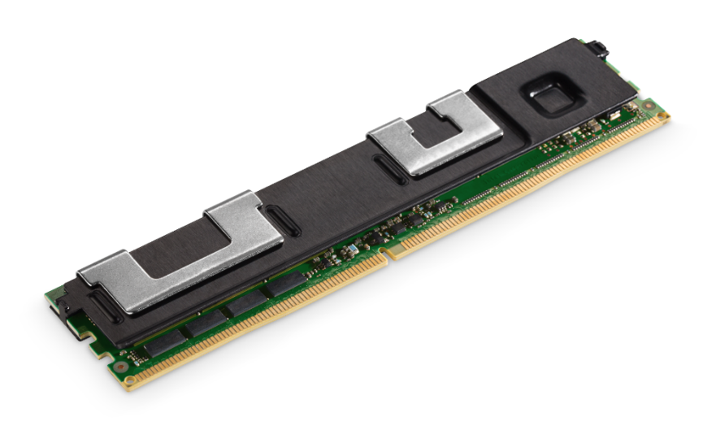
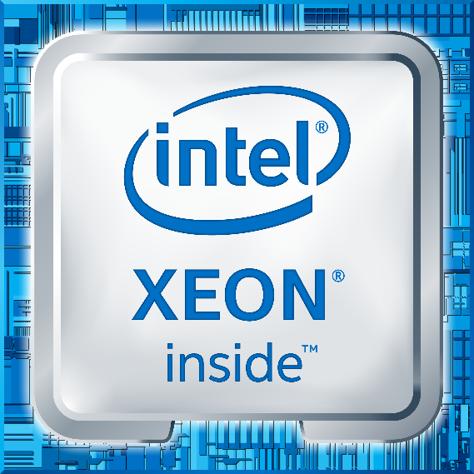
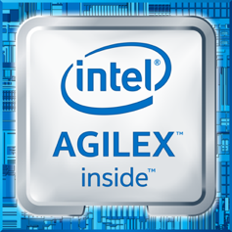
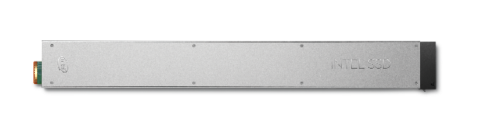
Data-Centric Portfolio
Move Faster
Store More
Process Everything
INTEL®
ETHERNET
800 SERIES
INTEL®
OPTANE™ DC Persistent Memory
DUAL Port
INTEL®
OPTANE™ DC SSD
2nd Generation
INTEL®
Xeon® Scalable
INTEL®
Xeon® D-1600
INTEL®
AGILEX™ FPGA
INTEL®
QLC 3D NAND SSD
Notes:
Today, we expand our portfolio to move, process and store data with the introduction of Intel Ethernet 800 adapters, Intel Optane DC D4800X SSDs, Intel QLC 3D NAND SSD, new Intel Optane DC Persistent Memory Modules, Intel Xeon D 1600 processors, Intel Agilex FPGAs and of course the momentum continues with 2nd Generation Intel Xeon Scalable Processors.
In total representing years of Intel engineering and eco system investment to deliver the foundation of the next generation of data centric innovation.

Slide 25

Transforming the Memory Storage Hierarchy
Memory
DRAM
hot tier
Persistent
Memory
Improving
memory capacity
Storage
Improving
SSD PERFORMANCE
SSD
warm tier
Delivering
EFFICIENT STORAGE
Intel® 3D NAND SSD
HDD / TAPE
cold tier
Notes:
The most disruptive capability of the 2nd generation Xeon Scalable processor may be the integrated control of breakthrough memory capacity including Intel Optane DC persistent memory.
Today’s memory and storage hierarchy rely on fast and expensive DRAM coupled with slower but cost effective storage technologies.
While larger memory sizes have been technically feasible, economic limitations have capped affordable memory capacity and limited memory hungry applications, like in-memory compute, big data analytics, high capacity VM environments, and real time fraud detection to process data in real time at the same time lacking persistence.
Intel Optane DC persistent memory addresses this.

Slide 26

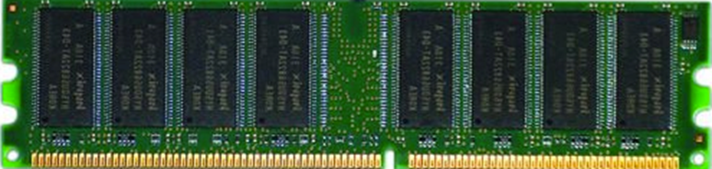

Goal: Efficient Data Centric Architecture
CPU
LLC
Core
L2
L1
pico-secs nano-secs
DRAM
hot tier
Memory Sub-System
10s GB
<100nanosecs
Optimize performance given cost and power budget
100s GB
<1microsec
Access Distribution
Move Data Closer to Compute
Maintain Persistency
Hot data
1s TB
<10microsecs
SSD
warm tier
Cooler data
← more often
less often →
SSD
10s TB
<100microsecs
Data Access Frequency
Intel® 3D Nand SSD
Network
Storage
HDD / TAPE
cold tier
10s TB
<100millisecs
Notes:
A typical data access frequency distribution looks like this….
<click once>
Optimize performance given cost and power budgets…need to MATCH the hot data to the hot tier (hot media types, like DRAM) and the cooler data to the cooler tiers (Cold media types like NAND)….as you see it in the memory/storage pyramid…
<click once>
…and how this looks in the data center architecture itself.
<click once>
Bringing more data closer to compute and adding persistency supports data centric architecture to be more efficient and effective.

Slide 27

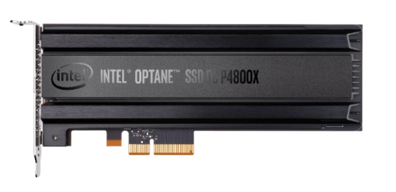
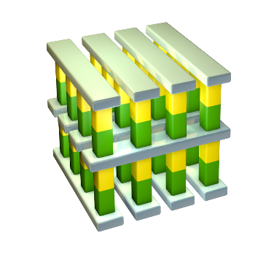

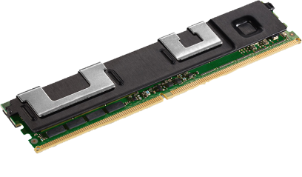
Technology Driven: Intel® Optane™ Technology Unleashing breakthrough performance for a new generation of computing
Intel® 3D XPoint™ Memory Media
Intel® building blocks
Intel® Optane™ Technology
1
2
3
Intel System
Memory Controller,
Interface HW, and SW IP
Breakthrough material advances for scalability & high performance
Notes:
The INTEL advantage where media and controller are designed by INTEL. As well as HW and Software IP. The building blocks of 3DXPoint+INTEL= Optane technology

Slide 28
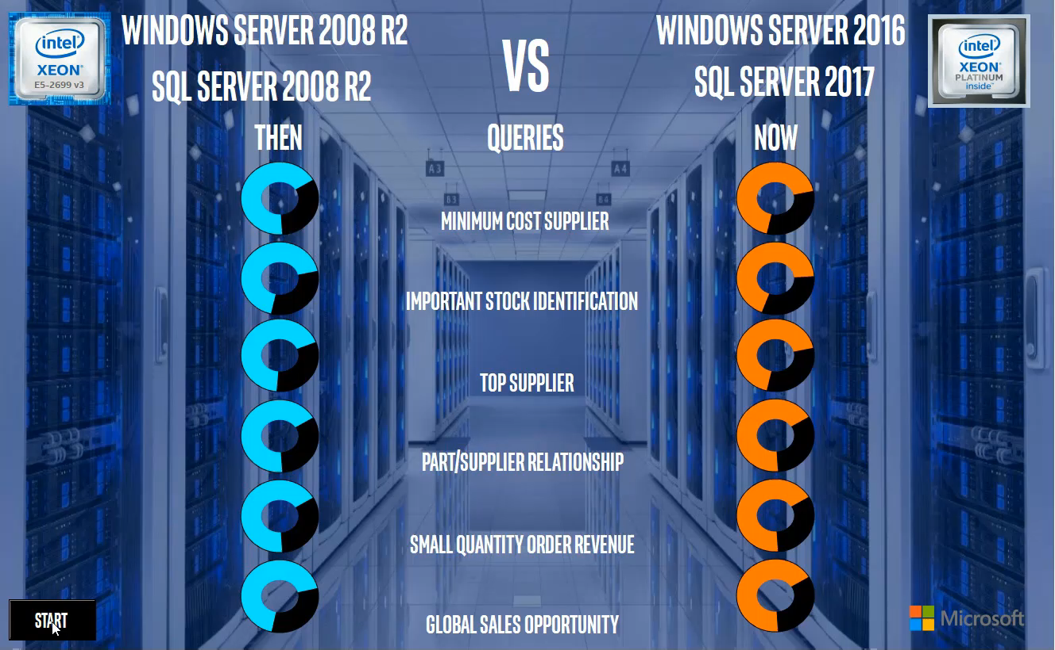


Reduced Query Runtimes⁴
With 2nd Gen Intel® Xeon® Scalable Processor + SQL Server 2017
Performance results are based on testing by Intel as of 3/13/2019 and may not reflect all publicly available security updates. See configuration disclosures for details. No product or component can be absolutely secure. Software and workloads used in performance tests may have been optimized for performance only on Intel microprocessors. Performance tests, such as SYSmark and MobileMark, are measured using specific computer systems, components, software, operations and functions. Any change to any of those factors may cause the results to vary. You should consult other information and performance tests to assist you in fully evaluating your contemplated purchases, including the performance of that product when combined with other products. For more complete information visit www.intel.com/benchmarks.
⁴ Configuration: See Notices & Disclaimers
Notes:
The demos shows how fast some of the most common queries run on a system build with Win Server 2016 and SQL Server 2017 and 2nd Gen Intel Xeon Scalable Processor.

Slide 29
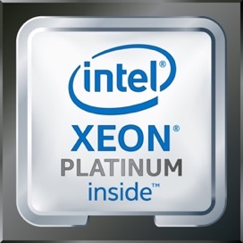
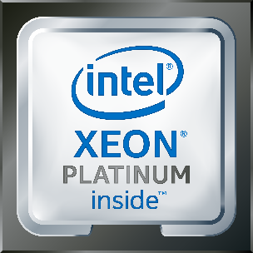
Faster Query Performance with 2nd Gen Intel® Xeon® Processor + SQL Server
Faster Data Warehouse Query Performance with latest sw & hw
Queries/hr.
Past Customer Experience
33,681 queries per hour at 1TB scale factor with a 4 year old system
Customer Experience Today
With 2nd Gen Intel® Xeon® Scalable processors:
836,261 queries per hour at 1TB scale factor
24.8X better
Performance results are based on testing by Intel as of 2/8/2019 and may not reflect all publicly available security updates. See configuration disclosures for details. No product or component can be absolutely secure.
Software and workloads used in performance tests may have been optimized for performance only on Intel microprocessors. Performance tests, such as SYSmark and MobileMark, are measured using specific computer systems, components, software, operations and functions. Any change to any of those factors may cause the results to vary. You should consult other information and performance tests to assist you in fully evaluating your contemplated purchases, including the performance of that product when combined with other products. For more complete information visit www.intel.com/benchmarks. 1. Configuration: See slide 13
*Other names and brands may be claimed as the property of others
Notes:
2 different swimlanes. Past Experience vs New
Data Warehouse Demo on a 4yr old server running SQL Server 2008 vs SQL Server 2017 on a Xeon Scalable Platform.
On the 4yr old system we are coming at ~34k queries / hr.
On the latest platform that jumps to 835k queries/hr. 24.8x better
This jump is attributed to new SW and HW.
You can consolidate servers as you migrate from old HW to new HW.

Slide 30

Memory Mode Example- Virtualized SQL Server
Increase VMs per node for multi-tenant virtualized Databases
ALL DRAM Configuration (768 GB)
22 Microsoft SQL VM instances with DRAM memory at ~$1,588 USD per VM
30 Microsoft SQL VM instances at ~$1,108 USD per VM
DRAM (192 GB) + Intel® Optane™ DC Persistent Memory (1024 GB)
36% more VMs per node¹
30% lower estimated HW cost per VM²
Performance results are based on testing by Intel as of 3/13/2019 and may not reflect all publicly available security updates. See configuration disclosures for details. No product or component can be absolutely secure. Software and workloads used in performance tests may have been optimized for performance only on Intel microprocessors. Performance tests, such as SYSmark and MobileMark, are measured using specific computer systems, components, software, operations and functions. Any change to any of those factors may cause the results to vary. You should consult other information and performance tests to assist you in fully evaluating your contemplated purchases, including the performance of that product when combined with other products. For more complete information visit www.intel.com/benchmarks.
¹⁻² Configuration: See Notices & Disclaimers
Notes:
This is a dBaaS scenario. Comparison between DRAM and Intel Persistent Memory.
In the all DRAM system we were able to run about 22 SQL VMs.
In the second scenario we see a jump to 30 SQL VMs.
That’s 36% jump in vm’s per node and 30% lower TCO per VM.

Slide 31

Intel® Select Solutions
with pre-defined and verified
infrastructure solution stacks
available from a
range of partners
BOOST
IT Velocity
>50
Verified Partner Solutions
with highly optimized configurations
of industry-leading
intel data center technologies
INCREASE
System Level Performance
to accelerate your
pace of innovation across
critical business workloads
UNPARALLELED
HW / SW Ecosystem
http://www.intel.com/selectsolutions
Notes:
Intel Select Solutions – Intels campaign to deliver optimized and pre-validated solutions to customers.
Workload optimization, configurations using the right Intel technology foundation delivering pre-verified performance, and room for system differentiation with solution provider enhancements, Select Solutions provide customers a path to accelerate data centric deployments.
There are currently over 50 verified partner solutions in market today.

Slide 32
Making workload acceleration Easy With Intel® Select Solutions
Analytics
Hybrid Cloud
Microsoft SQL Server Windows Server
Microsoft Azure Stack
UPDATED
Microsoft Azure Stack HCI
UPDATED
Microsoft SQL Server Linux*
UPDATED
* Coming Soon
iNTEL.COM/SELECTSOLUTIONS
Notes:
Here are the major Intel Select Solutions that Intel partnered with Microsoft. Intel launched Select solutions for SQL Server both on Win Server & Linux and are currently updating to the latest generation of Xeon Technology.

Slide 33
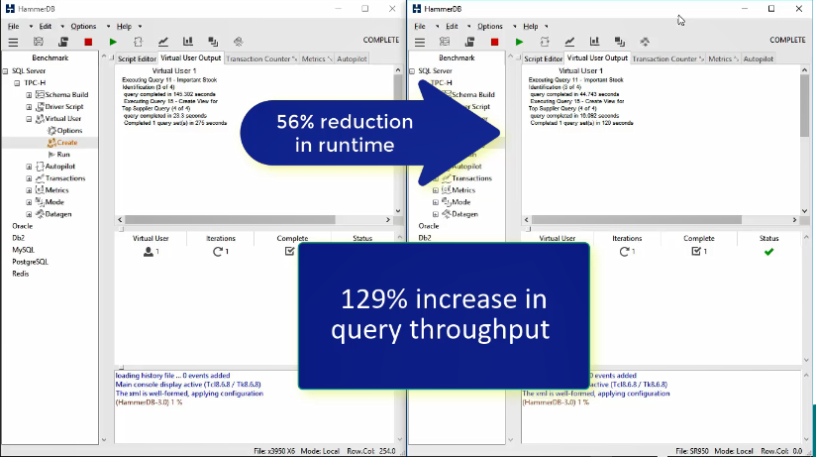
DAX Example- 30 TB Data Warehouse⁵
With 2nd Gen Intel® Xeon® Scalable Processor, Intel® Optane™ DC Persistent Memory + SQL Server 2019 CTP
Performance results are based on testing by Intel as of 3/31/2019 and may not reflect all publicly available security updates. See configuration disclosures for details. No product or component can be absolutely secure. Software and workloads used in performance tests may have been optimized for performance only on Intel microprocessors. Performance tests, such as SYSmark and MobileMark, are measured using specific computer systems, components, software, operations and functions. Any change to any of those factors may cause the results to vary. You should consult other information and performance tests to assist you in fully evaluating your contemplated purchases, including the performance of that product when combined with other products. For more complete information visit www.intel.com/benchmarks.
⁵ Configuration: See Notices & Disclaimers
Notes:
We turned the dialup to 30TB Data Warehouse and put it all on the memory bus. We used the HammerDB benchmark tool. Partnered with Lenovo on this.
On the left – it’s an 8 socket, SQL 2016, Win Server 2016 based system
On the right – it’s an 8 socket server based on 2nd Gen Xeon Scalable Processor with Intel Optane DC Persisten Memory and SQL Server 2019 CTP.
We put the entire 30TB on memory bus and ran handful of decision support queries.
We noticed a 56% reduction in runtime and 129% increase in query throughput.

Slide 34

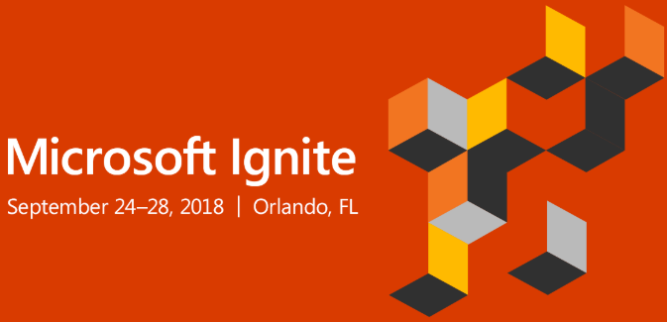
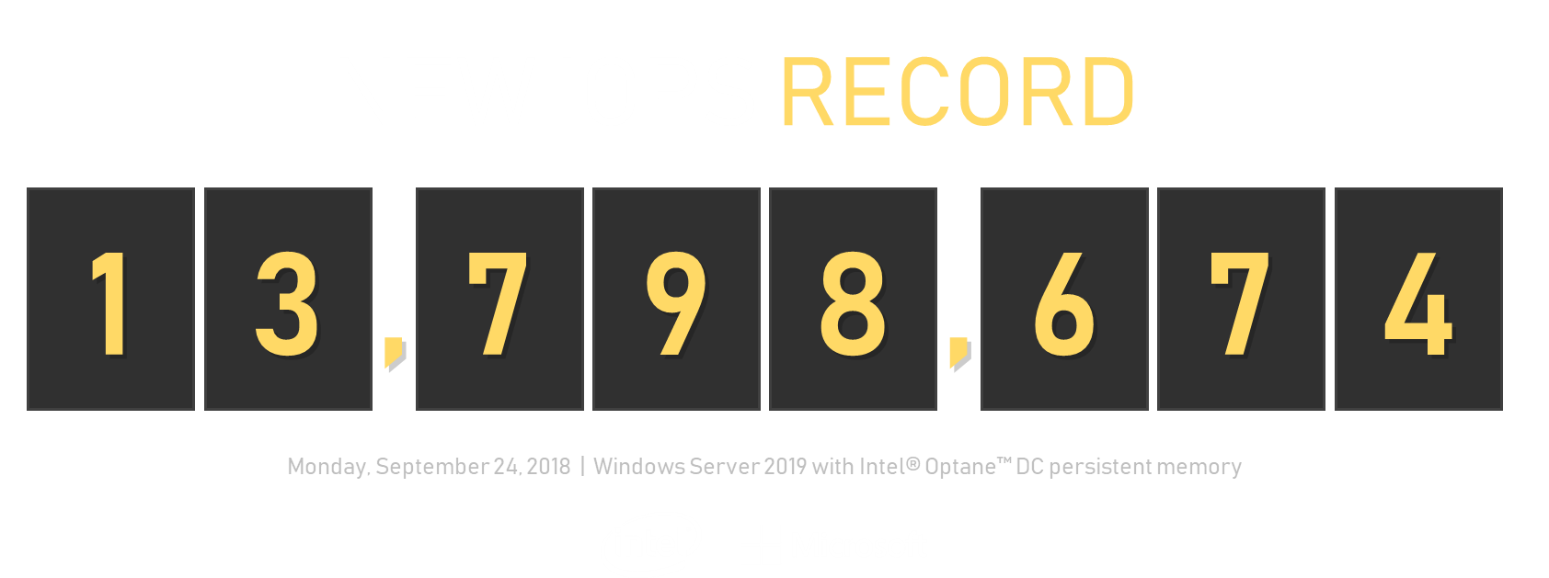
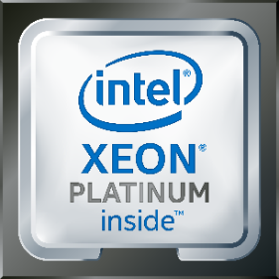
Microsoft Ignite ’18 Demo
The very latest from Intel
12 x Intel® S2600WFT
384 GB (12 x 32 GB) memory
2 x 28-core 8260 Intel® Xeon® Scalable processor
1.5 TB Intel® Optane™ DC Persistent Memory (as cache)
32 TB NVMe (4 x 8TB Intel® DC P4510) as capacity
2 x 25 Gbps RDMA NICs
Maximize IOPS read/write 4 kB random, 90% read, 10% write 9,459,587 IOPS
Maximize throughput 2 MB sequential, 100% read 535.86 GB/s
The very latest from Microsoft https://blogs.technet.microsoft.com/filecab/2018/10/30/Windows-server-2019-and-intel-optane-dc-persistent-memory/
Windows Server 2019
Insider Preview, build 17713
Hyper-V + Storage Spaces Direct
Maximize IOPS, all-read 4 kB random, 100% read
*Other names and brands may be claimed as the property of others
Notes:
See the demo at - https://www.youtube.com/watch?v=INQQvmFWl4I
Intel & Microsoft delivered a staggering 13.7M IOPS by leveraging the latest SW & HW innovations. It was particularly a showcase of the new Intel Optane DC Persistence Memory.

Slide 35
Notices and Disclaimers
Intel technologies’ features and benefits depend on system configuration and may require enabled hardware, software or service activation. Performance varies depending on system configuration.
No product or component can be absolutely secure.
Tests document performance of components on a particular test, in specific systems. Differences in hardware, software, or configuration will affect actual performance. For more complete information about performance and benchmark results, visit http://www.intel.com/benchmarks .
Software and workloads used in performance tests may have been optimized for performance only on Intel microprocessors. Performance tests, such as SYSmark and MobileMark, are measured using specific computer systems, components, software, operations and functions. Any change to any of those factors may cause the results to vary. You should consult other information and performance tests to assist you in fully evaluating your contemplated purchases, including the performance of that product when combined with other products. For more complete information visit http://www.intel.com/benchmarks .
Intel® Advanced Vector Extensions (Intel® AVX)* provides higher throughput to certain processor operations. Due to varying processor power characteristics, utilizing AVX instructions may cause a) some parts to operate at less than the rated frequency and b) some parts with Intel® Turbo Boost Technology 2.0 to not achieve any or maximum turbo frequencies. Performance varies depending on hardware, software, and system configuration and you can learn more at http://www.intel.com/go/turbo.
Intel's compilers may or may not optimize to the same degree for non-Intel microprocessors for optimizations that are not unique to Intel microprocessors. These optimizations include SSE2, SSE3, and SSSE3 instruction sets and other optimizations. Intel does not guarantee the availability, functionality, or effectiveness of any optimization on microprocessors not manufactured by Intel. Microprocessor-dependent optimizations in this product are intended for use with Intel microprocessors. Certain optimizations not specific to Intel microarchitecture are reserved for Intel microprocessors. Please refer to the applicable product User and Reference Guides for more information regarding the specific instruction sets covered by this notice.
Cost reduction scenarios described are intended as examples of how a given Intel-based product, in the specified circumstances and configurations, may affect future costs and provide cost savings. Circumstances will vary. Intel does not guarantee any costs or cost reduction.
Intel does not control or audit third-party benchmark data or the web sites referenced in this document. You should visit the referenced web site and confirm whether referenced data are accurate.
*Other names and brands may be claimed as property of others.
Intel, the Intel logo, Xeon, and Optane are trademarks of Intel Corporation in the United States and other countries.
© 2019 Intel Corporation.

Slide 36
Notices and Disclaimers
Performance results are based on testing as of dates shown in configuration and may not reflect all publicly available security updates. See configuration disclosure for
details. No product or component can be absolutely secure. Software and workloads used in performance tests may have been optimized for performance only on Intel
microprocessors. Performance tests, such as SYSmark and MobileMark, are measured using specific computer systems, components, software, operations and functions.
Any change to any of those factors may cause the results to vary. You should consult other information and performance tests to assist you in fully evaluating your
contemplated purchases, including the performance of that product when combined with other products. For more complete information
visit www.intel.com/benchmarks.
1, 2 36% more VMs per node & 30% lower estimated cost per VM. Tested by Intel Corp as of 1/31/2019. 1-node, 2x Intel® Xeon® Platinum 8272L Processor with 768 GB (24 slots / 32 GB / 2666) total memory, Windows Server 2019, 1x Samsung PM963 M.2 960GB, 7x Samsung PM963 M.2 960GB, 4x Intel SSD DC S4600 (1.92TB), OLTP Cloud Benchmark, result: 22 VMs per node, vs. 1-node, 2x Intel® Xeon® Platinum 8272L Processor with 1216 GB (12 slots / 16 GB / 2666 DDR4 memory + 8 slots / 128 GB Intel® Optane™ DC persistent memory) total memory, Windows Server 2019, 1x Samsung PM963 M.2 960GB, 7x Samsung PM963 M.2 960GB, 4x Intel SSD DC S4600 (1.92TB), OLTP Cloud Benchmark, result: 30 VMs per node. Pricing Guidance as of March 1, 2019. Intel does not guarantee any costs or cost reduction. You should consult other information and performance tests to assist you in your purchase decision.
3 Reduced query runtimes with 2nd Gen Intel® Xeon® Scalable Processor, Intel® Optane™ DC Persistent Memory + SQL Server 2019 CTP. Tested by Lenovo Corp and Intel Corp as of 3/31/2019. Lenovo x3590 X6, 8x Intel® Xeon® E7-8890 v3 processors, 12 TB (192 slots / 64GB / 1600) total memory, on Windows Server 2016 Standard Edition, 16x 6.4TB PCIe SSDs, SQL Server 2016 Enterprise Edition, vs. Lenovo SR950, 8x Intel® Xeon® Platinum 8280L processors, 8 TB (64 slots / 128 GB / 2666) total memory, 16 TB (32 slots / 512 GB) Intel® Optane™ DC persistent memory, on Windows Server 2019 Data Center Edition, SQL Server 2019 CTP 2.3. Workload details: 30 TB Data Warehouse, 1 user issuing a set of 22 DSS queries, 4 queries demonstrative of possible gains visualized.

Slide 37
Thank You

